Slide 1
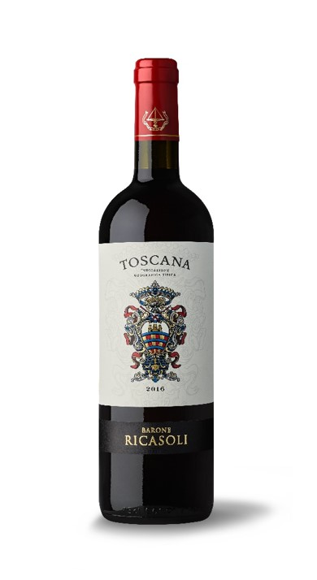
Toscana IGT 2016
GROWING SEASON
The Autumn and Winter were very mild with below-freezing temperatures only for part of January and rainfall of about 17 inches. Springtime temperatures were average bringing heat and humidity towards the end of May and early June. This diminished the fruit set causing a thinning effect in the clusters which was good for the Sangiovese. Two hail storms at the end of May also led to loss of flowers, thus reducing per plant growth. Summer was hot and dry with late-July and mid-August rains giving some relief to the vines and helping them during the period of veraison. Harvest began in early September, with mid-to-high daytime temperatures for this period of the year followed by drops in nighttime temperatures to 50°F - 59°F favoring the accumulation of phenolic compounds.
TASTING NOTES
Ruby red color with delicate aromas of red berries and small red fruits followed by a soft mouth feel with nice acidity giving way to a well- balanced and pleasant finish.
GRAPE VARIETIES
60% Sangiovese, 30%, Merlot, 10% Cabernet Sauvignon
WINEMAKING NOTES
Fermentation takes place in stainless steel tanks at controlled temperatures between 75.2°F – 80.6°F with 14-16 days of skin contact.
AGING
3 – 4 months in tonneaux of third passage.

